Slide 1

Predicting customer buying behaviour
27/04/2023

Slide 2
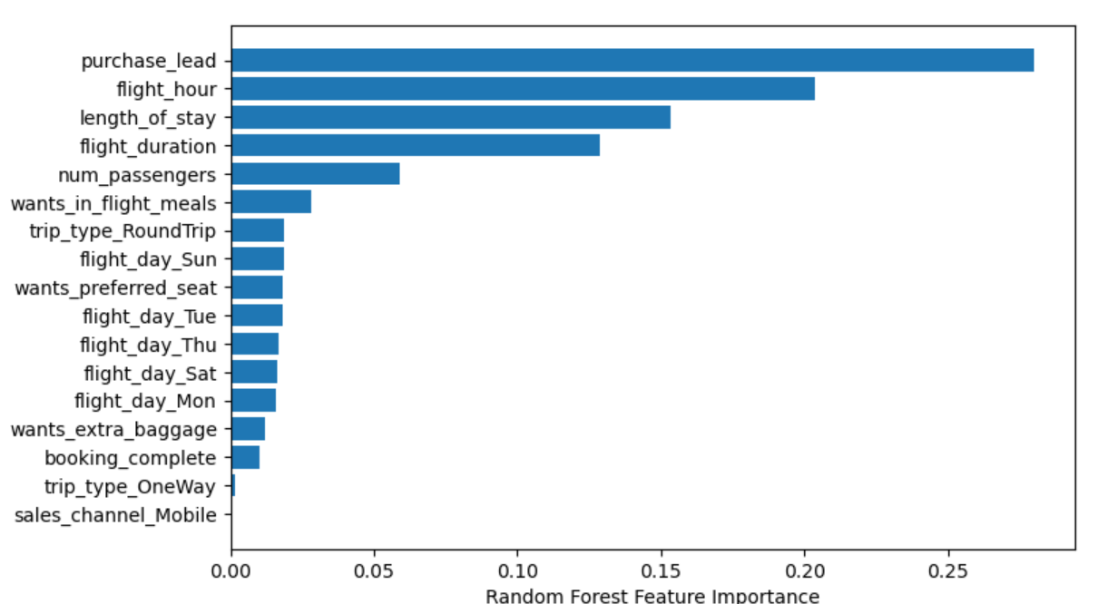
predictive model to understand factors that influence buying behaviour
We have trained the data set with Random forest classifier model and received
ACCURACY: 82.00
Purchase lead
Flight hour
Length of stay
4. Flight duration
5. Number of passenger
Made up the top 5 features which influence
Customer buying behaviour.
The nature of imbalance in the booking column affected the accuracy of the model.
More attention could be given to the features with more importance to improve customer booking.

